Slide 1


Smart Produkts & Solutions Assignment 5 – Project Management Methods SPS bbM, WS 2017/18

Slide 2
HANDOUT NICHT VERGESSEN
Assignment 5 – Project Management Methods
Planning vehicle for „Mars Expedition“
Anna Duregger,
Christoph Jungwirth,
Christian Gruber

Slide 3
Agenda
Project use case
Project at a glance
Project supporting tools
Risk evaluation of the Project
Traditional vs. Agil Methods

Slide 4
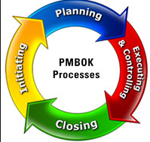
Project use case
Phase planning
Conception phase
Define and Planning phase
Execution Phase
Mars Landing
Structure
Set up activities
Work step by step

Slide 5
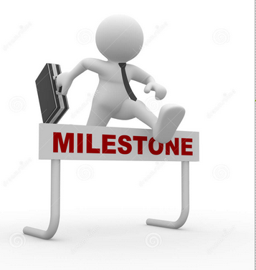
Project use case
Milestones
1st: structure, basic concept, distribution of roles
2nd: prototyping our Mohne
3rd: optimization for our finalisation phase
Control project progession
Relief project planning

Slide 6
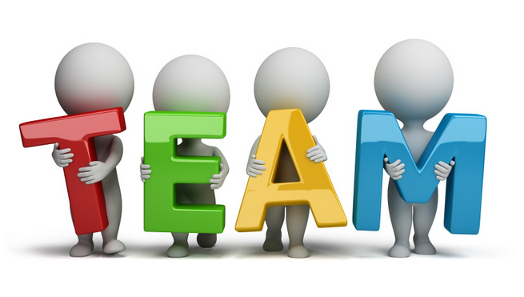
Distribution of roles
Project Manager and Deputy Project Manager
Head of Construction
Head of computer engineering
Head of electronic engineering
Decision maker
Responsibility

Slide 7
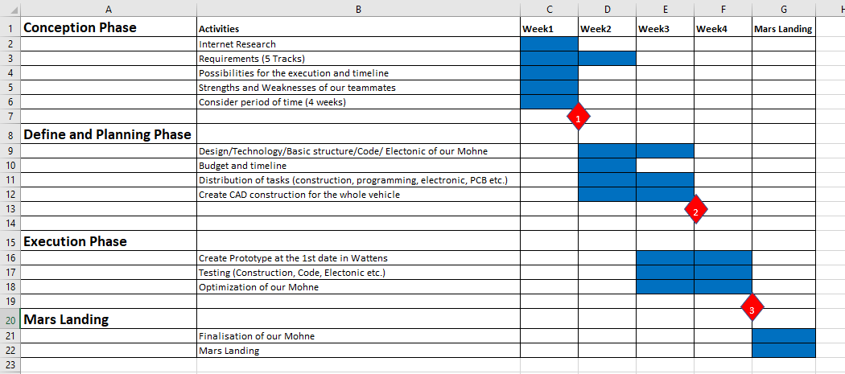
Project at a glance

Slide 8
Project supporting tools
GitHub
Used as a Collaboration Tool for the Project
Separate the Tasks regarding the project phases
In addition to the project plan → more clearly & detailed
Templates (based on Excel)
Project owner Requirements (Tasks for the Robot)
Team Member Structure (Who is Who?)
Risk analysis (for the Robot)
Technical Requirements (Construction)

Slide 9
Risk evaluation of the Project
Evaluating potential Risks of the Project regarding the customer requirements
Create controlling tools for the detected risks
Finding solutions for the come out risks
Discriminate between project risks and standard risks
Standard risks | Project risks
Competing goals | Technical Issues
Project environment | Time Table / Delivery Schedule
Stakeholder | Customer Requiremants

Slide 10
Traditional vs. Agil Methods

